Slide 1
Study Design in Epidemiology and Ecology
E²M²: Ecological and Epidemiological Modeling in Madagascar
Centre ValBio
Ranomafana National Park, Madagascar
December 2022

Slide 2

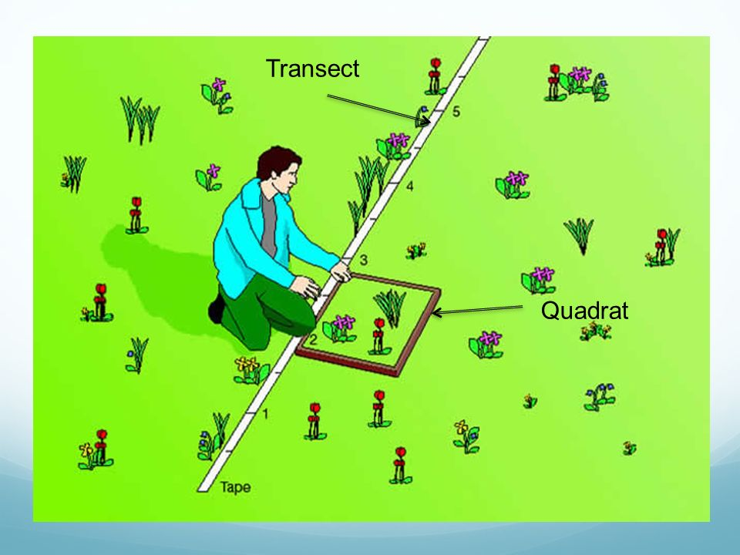
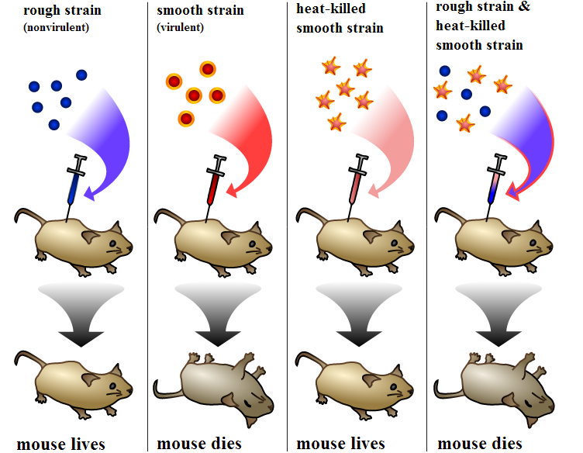
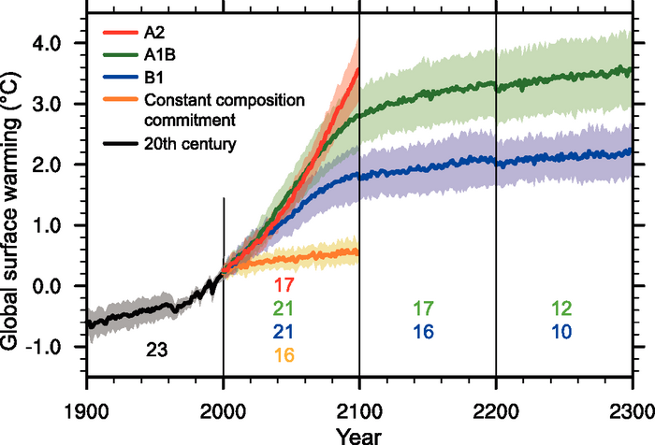
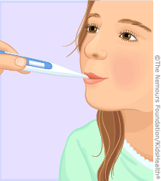
Data: Sources of x and y
Observational | Experimental | Simulated
- Just measure x and y | - Interfere with x or the relationship between x and y | - Create a relationship between x and y
Observational | Experimental | Simulated
- Just measure x and y | - Interfere with x or the relationship between x and y | - Create a relationship between x and y
Empirical data

Slide 3
Data: Sources of x and y
Observational | Experimental | Simulated
- Just measure x and y | - Interfere with x or the relationship between x and y | - Create a relationship between x and y
Observational | Experimental | Simulated
- Just measure x and y | - Interfere with x or the relationship between x and y | - Create a relationship between x and y
How do we choose the best method of data collection?
Empirical data

Slide 4
Data: Sources of x and y
Observational | Experimental | Simulated
- Just measure x and y | - Interfere with x or the relationship between x and y | - Create a relationship between x and y
Observational | Experimental | Simulated
- Just measure x and y | - Interfere with x or the relationship between x and y | - Create a relationship between x and y
How do we choose the best method of data collection?
The ‘best method’ will depend on the question!
Empirical data

Slide 5
Model-Guided Field Work

Slide 6
Epidemiological Study Design
Target Population
Target: Population to which it might be possible to extrapolate results of the study

Slide 7
Epidemiological Study Design
Target Population
Target: Population to which it might be possible to extrapolate results of the study
Source Population
Source: Population from which study participants are drawn

Slide 8
Epidemiological Study Design
Target Population
Target: Population to which it might be possible to extrapolate results of the study
Source Population
Source: Population from which study participants are drawn
Study Population
Study: Actual sampled population

Slide 9
Epidemiological Study Design
Target Population
Target: Population to which it might be possible to extrapolate results of the study
Source Population
Source: Population from which study participants are drawn
Study Population
Study: Actual sampled population
Well-designed studies allow us to make inferences about the target population

Slide 10
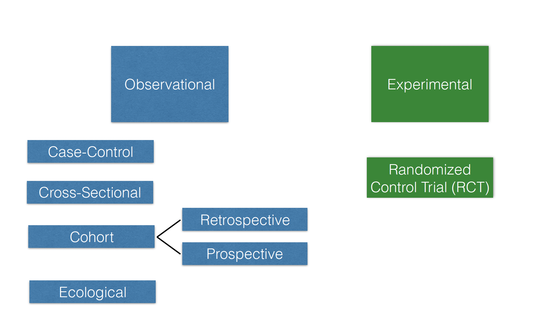
Different Study Types in Epidemiology

Slide 11
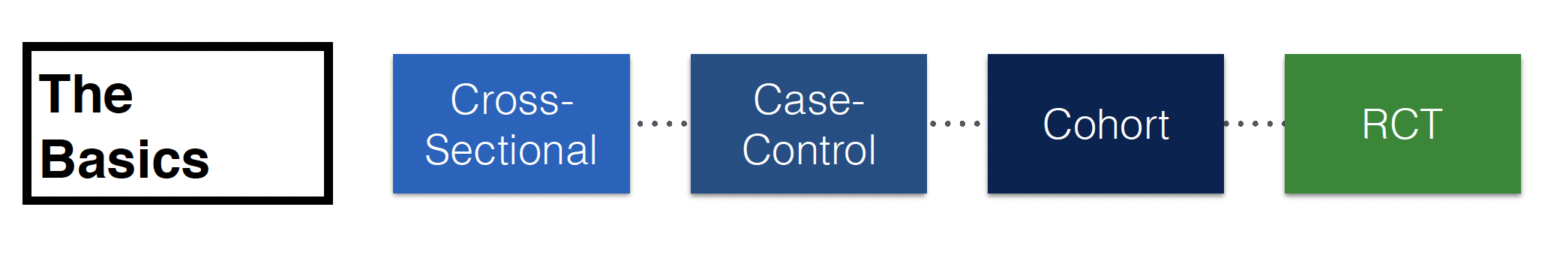

Slide 12
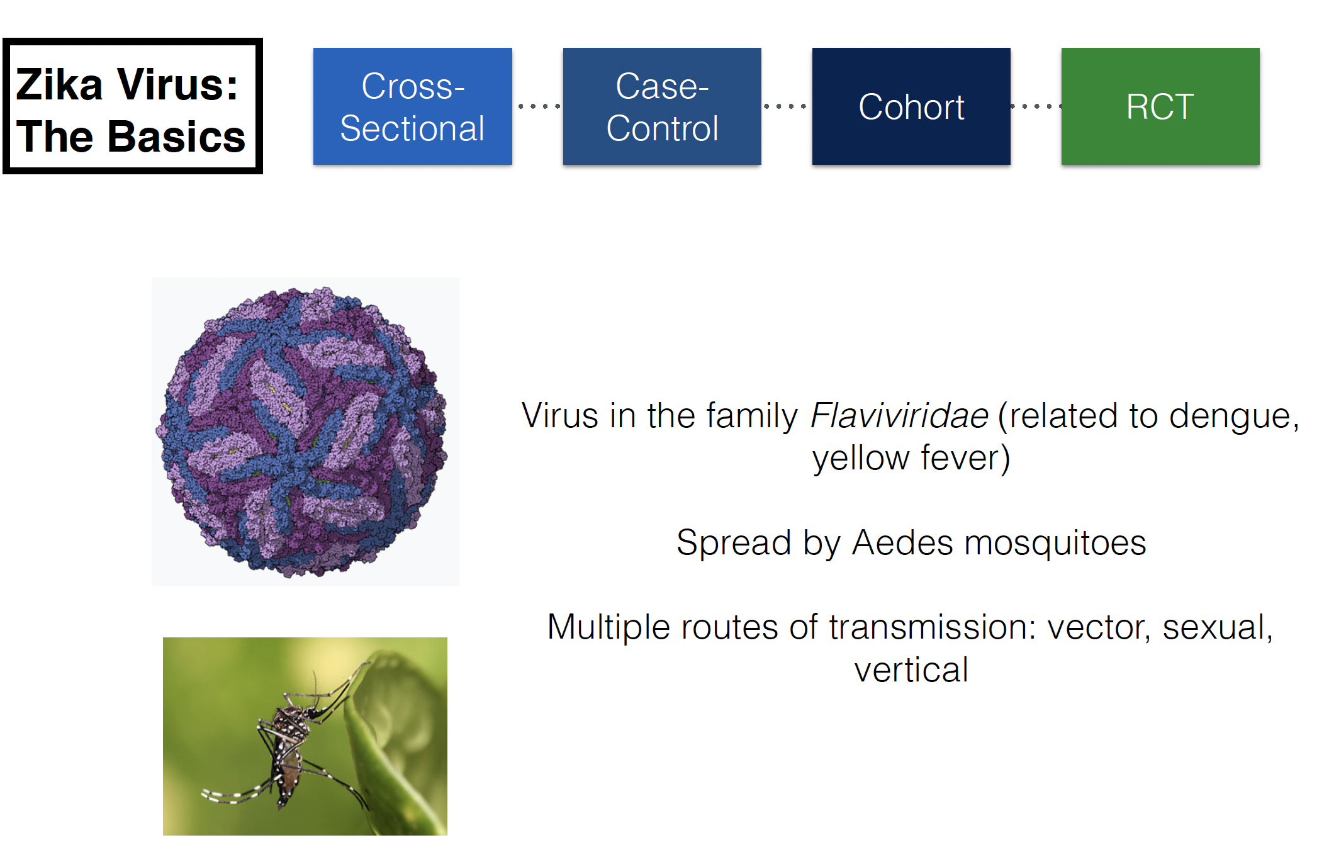

Slide 13
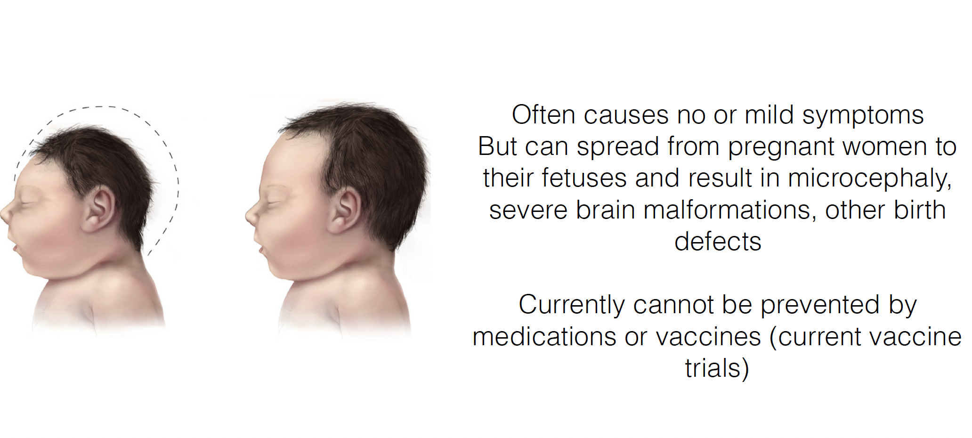

Slide 14
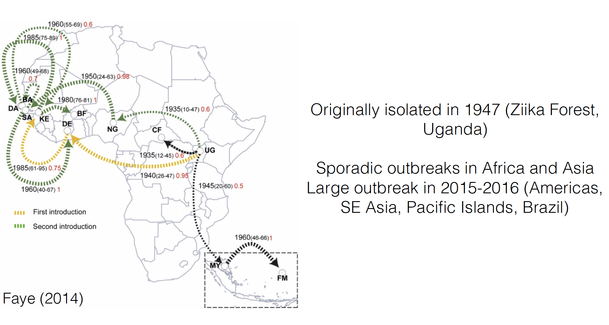

Slide 15
Cross-Sectional Study
Examines relationship between diseases and other variables of interest (e.g. geographic distribution)
Presence/absence of disease is determined for all members of a population
Commonly used to estimate prevalence (rather than incidence)
A single snapshot of the population at a moment in time
Exposure and outcome are assessed simultaneously

Slide 16
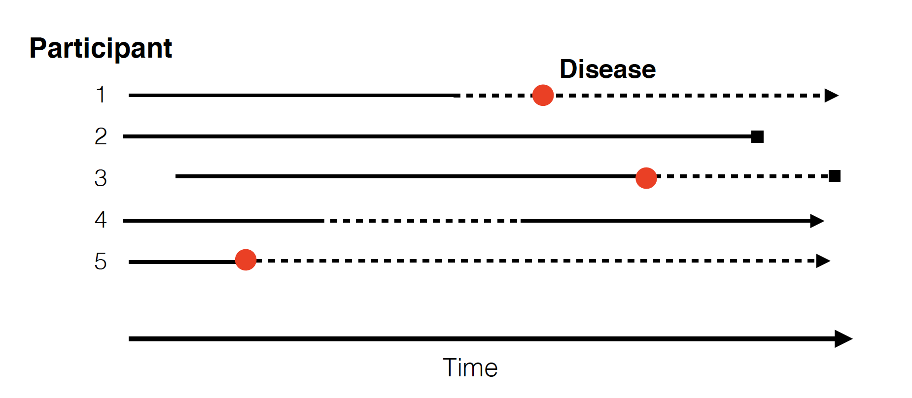
Cross-Sectional Study

Slide 17
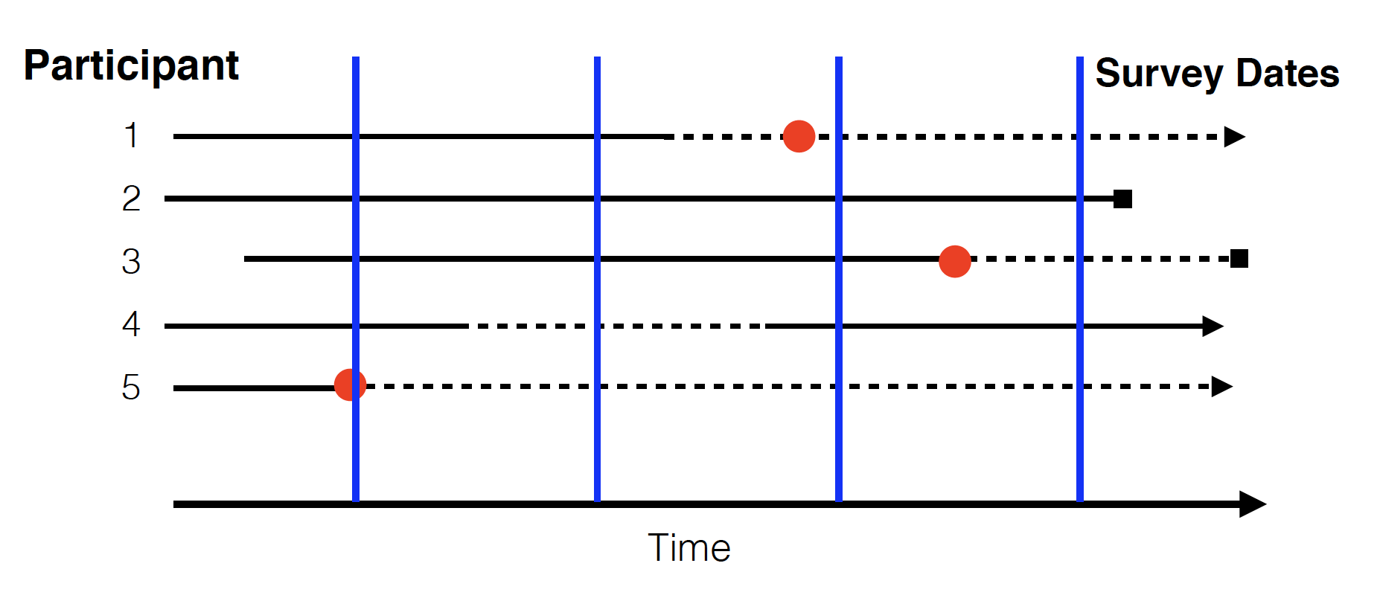
Cross-Sectional Study

Slide 18
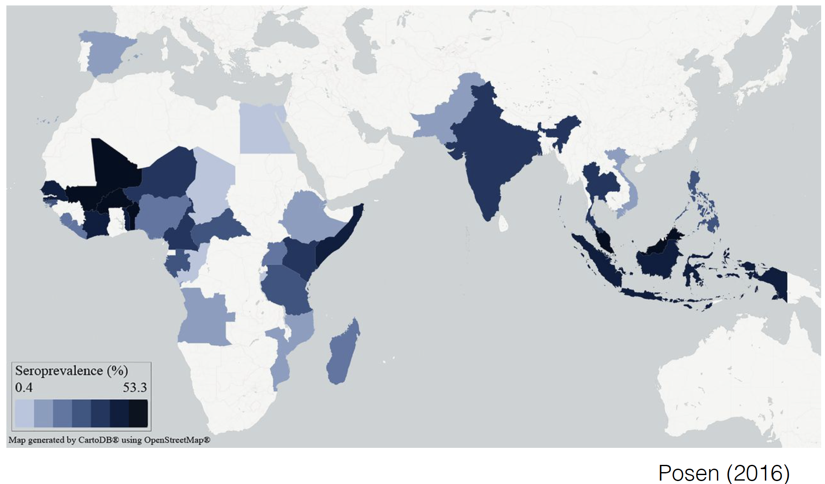
Cross-Sectional Study

Slide 19
Case Control Study
The observational epidemiological study of persons with a disease of interest and a suitable control group of persons without the disease
Potential relationship of a suspected risk factor or an attribute to the disease is examined by comparing the the disease and non-diseased subjects with regard to how frequently the factor or attribute is present in each of these groups.

Slide 20
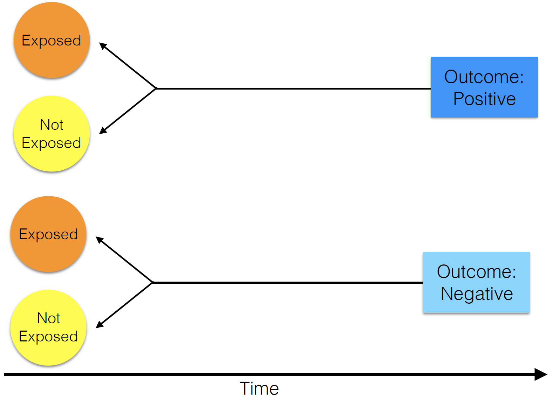
Case Control Study

Slide 21
Case Control Study
What is the relationship between maternal Zika infection and microcephaly?

Slide 22
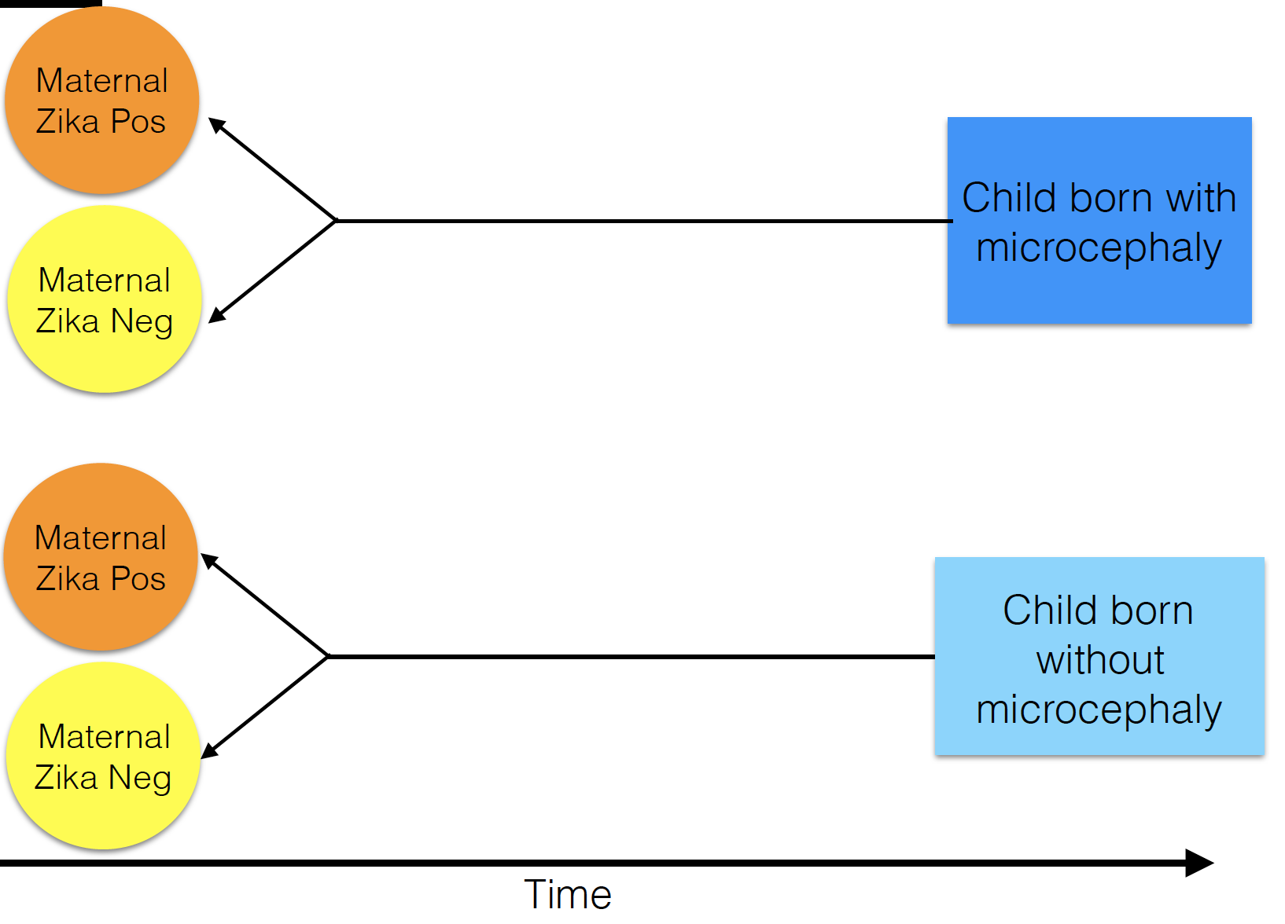
Case Control Study

Slide 23
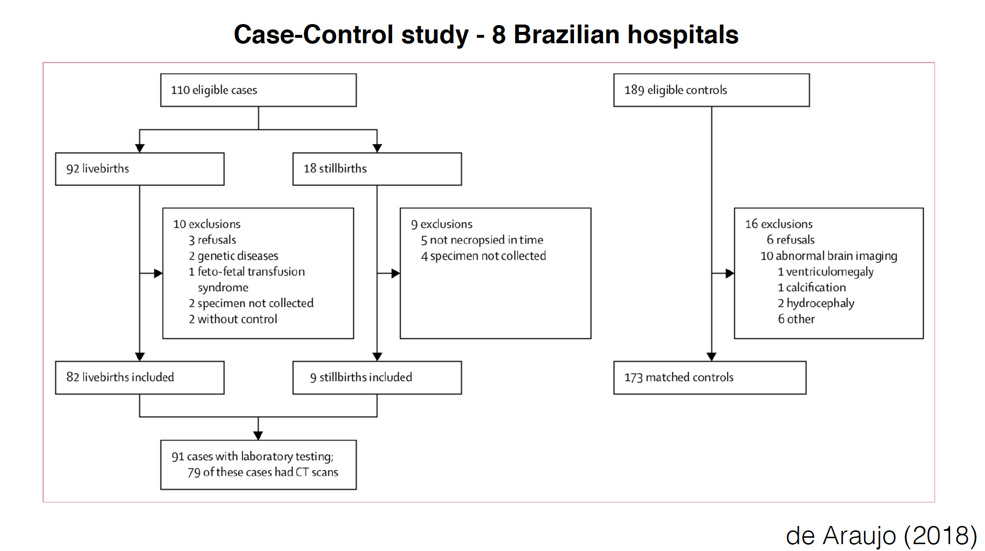
Case Control Study

Slide 24
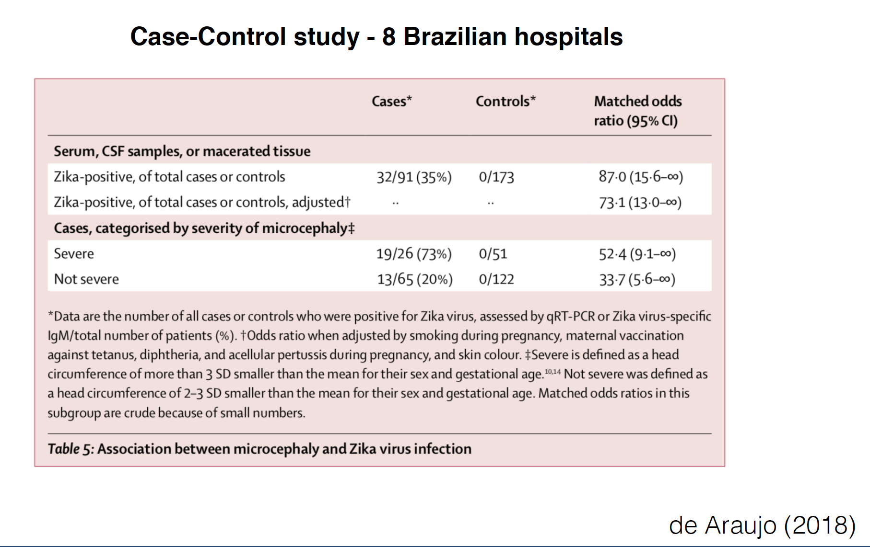

Slide 25
Cohort Study
Enrolled group of people who have a common experience or grouping.
Age cohort, risk cohort
General population sample
Clinic based
Prospective or retrospective

Slide 26
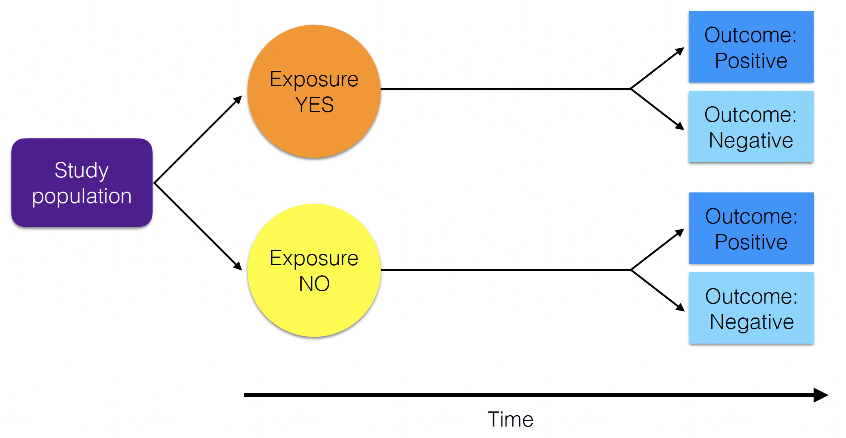
Cohort Study

Slide 27
Cohort Study
What is the rate of maternal-fetal transmission of Zika virus?

Slide 28
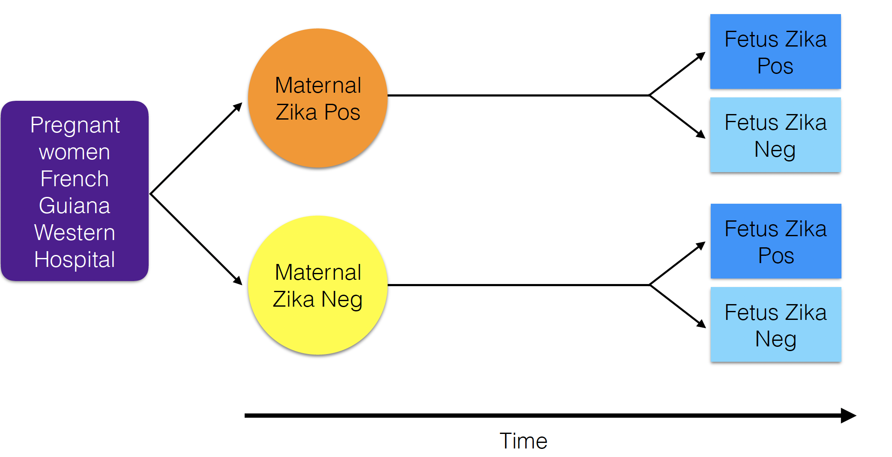
Cohort Study

Slide 29
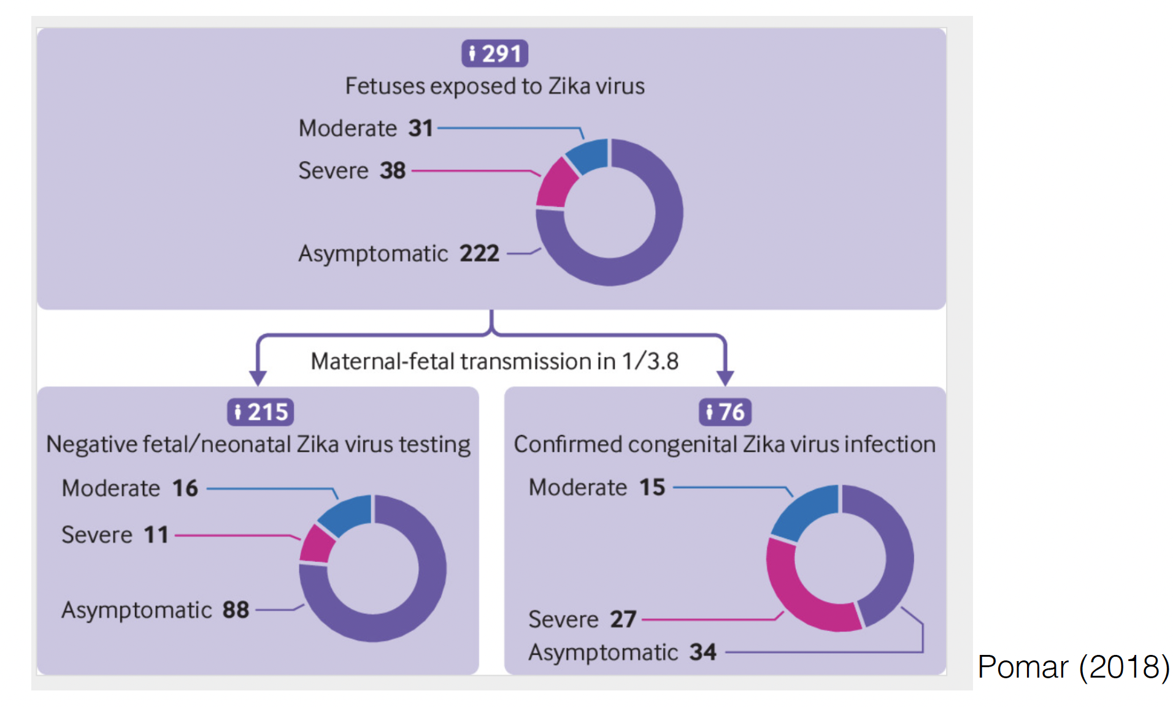
Cohort Study

Slide 30
Randomized Controlled Trial
Experiment in which subjects are randomly allocated into groups (test and control that are comparable) to receive or not to receive a preventative or a therapeutic procedure or intervention.
Results are assessed by comparison of rates of disease, death, recovery, or other outcome in the study groups.
Generally thought of as the most rigorous method of hypothesis testing.
Randomization should be blinded!

Slide 31
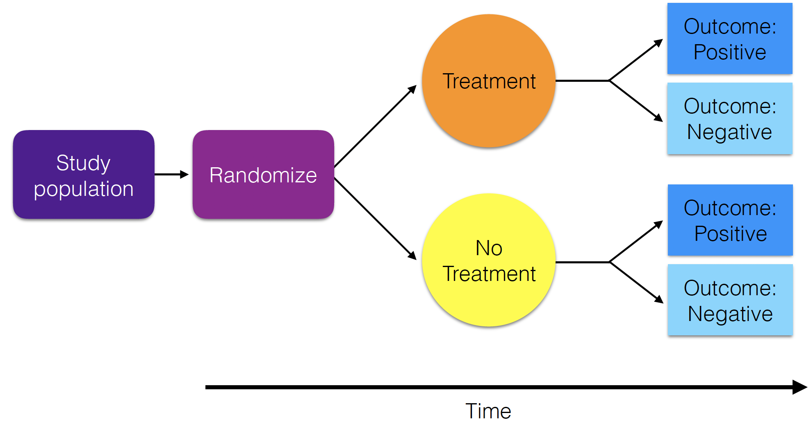
Randomized Controlled Trial

Slide 32
Randomized Controlled Trial
What is the effectiveness of a Zika containing vaccine?

Slide 33
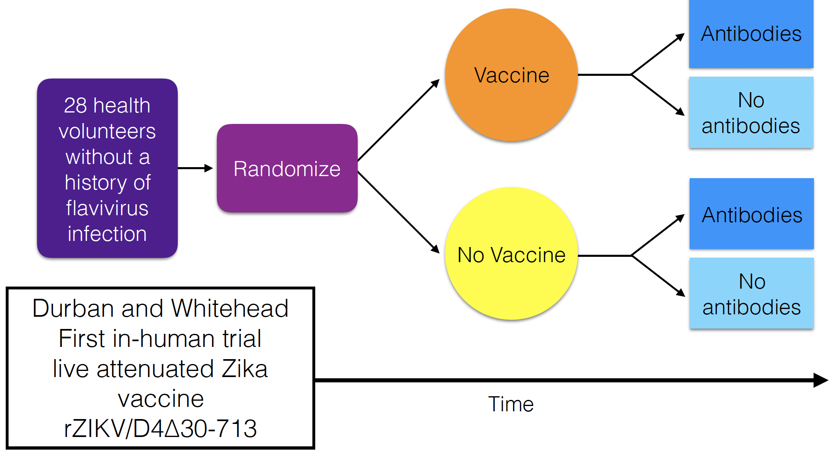
Randomized Controlled Trial

Slide 34
Different Study Types in Epidemiology

Slide 35
Different Study Types in Epidemiology
In epidemiology, ‘ecological study’ refers to a study used to understand the relationship between outcome and exposure at a population level, where 'population' represents a group of individuals with a shared characteristic such as geography, ethnicity, socio-economic status of employment.
Ex: What is the correlation between prevalence of TB and country-level GDP?

Slide 36
Ecological Study (Sampling) Design
Transects
Plots
Points

Slide 37
Ecological Study (Sampling) Design
Transects
Plots
Points
Often with randomized site selection.
Or, sometimes in a paired design.
Replication is key!

Slide 38
Ecological Study (Sampling) Design
Transects
Transects
Plots
Plots
Points
Points
Often with randomized site selection.
Or, sometimes in a paired design.
Replication is key!
Ecological manipulation

Slide 39
Ecological Study (Sampling) Design
Transects
Transects
Plots
Plots
Points
Points
Often with randomized site selection
Or, sometimes in a paired design.
Replication is key!
Ecological manipulation
The most appropriate sampling design will depend on your study system and research question. You should simulate data before carrying out your study to test your analytical approach.

Slide 40
Power Analysis
Simulation with mechanistic models
Packages with

